Slide 1
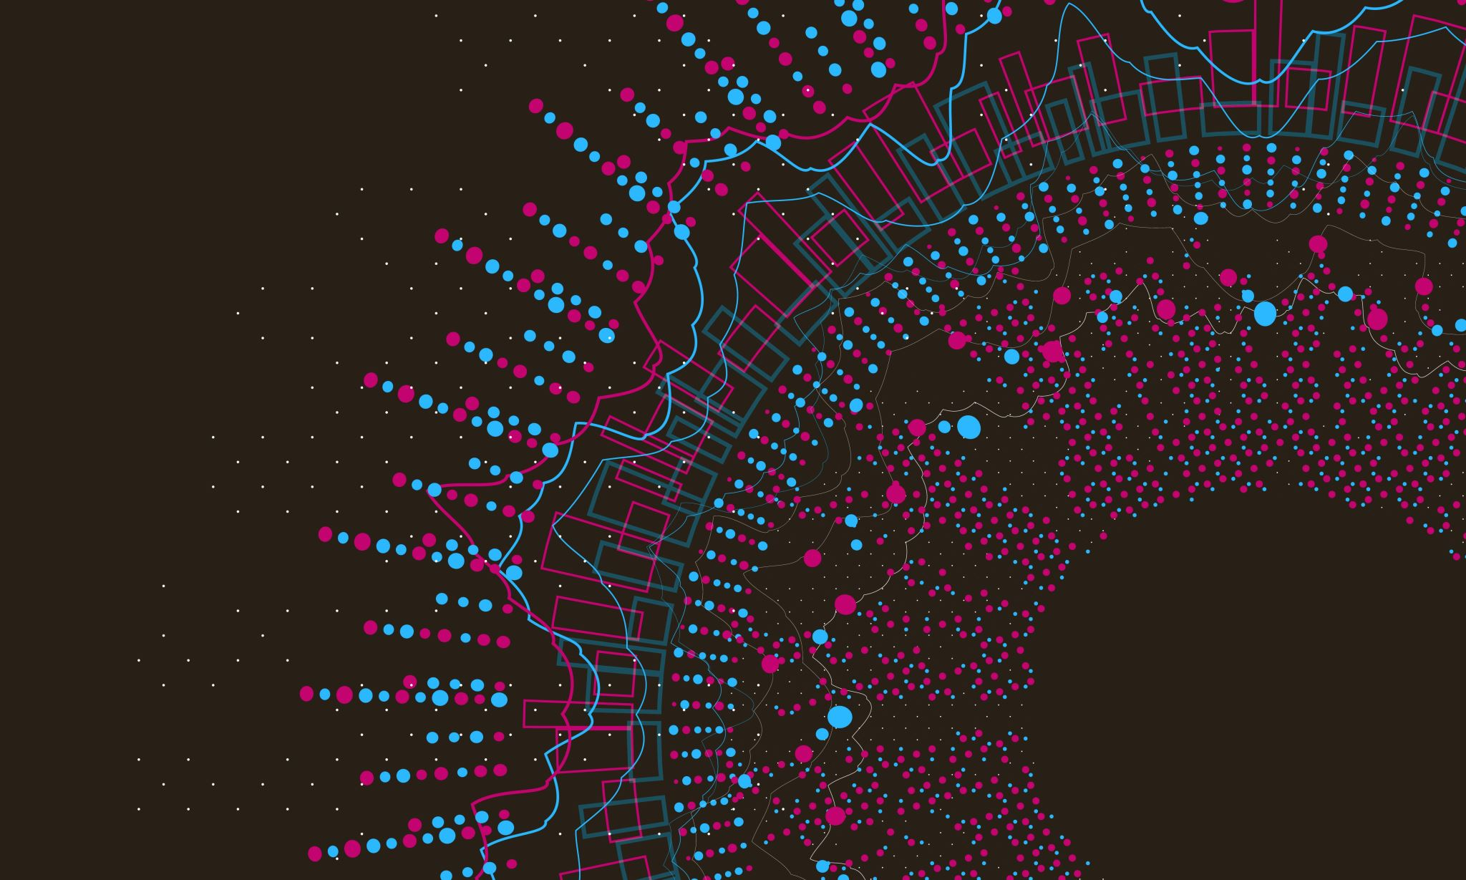
Secure DBaaS for Health Records
Professor: Maha Allouzi
Team Members:
Pingili Gayathri
Harsha Vani Rongala
Sabiha Nazareen Shaik
Ajay Kumar Galla

Slide 2
Problem statement
This Project addresses security issues related to Database as a Service (DBaaS) infrastructure in distributed computing. As DBaaS becomes a cloud-based management system, it provides data flexibility and reliability, reducing customers' efforts to manage their own data. However, the focus on the potential fragmentation of data security is different due to the semi-confidential nature of the cloud environment. Malicious people can collect information without permission.
To mitigate these security concerns, it is recommended to install, deploy, and evaluate a reliable DBaaS. The goal is to protect customer data stored in the database while leveraging distributed computing. This project considers the clean development of medical records containing important features such as first name, surname, gender, age, weight, class, and health history. The aim is to ensure the distribution, integrity, and access to the management of sensitive data.

Slide 3
The project is also about measures to increase safety and comfort. Scrambling data before sending it to the dataset can increase security, but it can also make the dataset problematic. The role therefore aims to coordinate the ability to obtain information and manage the effectiveness of information issues. The overall goal is to increase the security of the DBaaS framework, especially in cases where cloud environments are considered semi-trusted.

Slide 4
INTRODUCTION
In the modern times, safeguarding sensitive health records has emerged as a paramount concern, given the significant threats that data breaches represent to privacy and confidentiality. DBaaS, or Database as a Service, presents a novel chance to efficiently handle healthcare data. However, there remain persistent concerns regarding the security of data, particularly in semi-confidential environments. Fraudulent persons exploit vulnerabilities to obtain illegal access to information, underscoring the need for robust encryption methods.
Introducing Secure DBaaS for Health Records, a groundbreaking endeavor designed to enhance the security of healthcare data in distributed computing platforms. The objective of this project is to establish an optimal balance between data security and usability by prioritizing the encryption of vital patient information before it is stored. The project seeks to transform the management of health data by emphasizing a comprehensive table that consolidates crucial information, including name, weight, gender, height, age, and health history, mobile number. This project intends to protect sensitive data by implementing, deploying, and evaluating reliable DBaaS solutions.

Slide 5
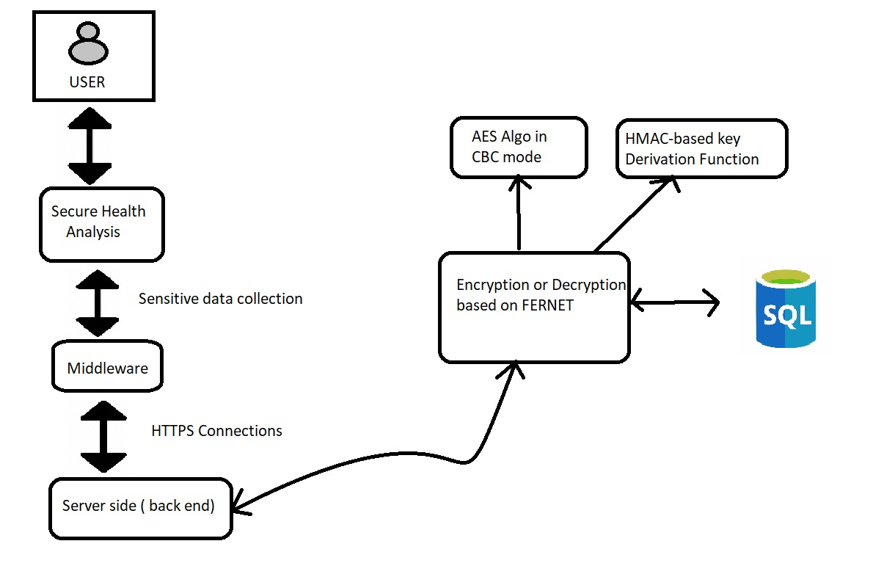
Workflow of the proposed method

Slide 6
EXISTING SYSTEM
In current healthcare data management systems, there are several challenges and weaknesses:
Limited Security Measures : Many current systems don't have strong enough ways to keep data safe, which can let unauthorized people access patient information.
Basic Access Control : The way people get into these systems is often simple, like just using a username and password without extra security steps like answering security questions.
Risk of Data Breaches : Because of the weak security in place, patient data in these systems can be easily accessed or stolen, which can cause privacy problems and legal issues.

Slide 7
DISADVANTAGES OF EXISTING SYSTEM
Current healthcare data systems lack sufficient security, leaving patient information exposed to unauthorized access and potential theft due to over-reliance on basic credentials like passwords alone.
Enhancing protection through advanced security features like role-based access controls and multi-factor authentication is crucial to prevent data and login compromises.
Inadequate security postures can impede healthcare organizations' ability to comply with stringent data privacy laws such as HIPAA and GDPR, risking penalties and reputational harm.

Slide 8
PROPOSED SYSTEM
Our proposed system implements robust encryption algorithms to safeguard patient records, preventing unauthorized individuals from accessing or tampering with the data.
An additional security layer is established through multi-factor authentication, requiring users to provide more than just a password, such as answering security questions, during the login process.
Access privileges are meticulously managed through role-based access control, ensuring that each user's system capabilities align with their designated role within the healthcare organization (e.g., doctors, nurses, administrative staff).

Slide 9
ADVANTAGES OF PROPOSED SYSTEM
Our proposed system implements robust encryption algorithms to safeguard patient records, preventing unauthorized individuals from accessing or tampering with the data.
An additional security layer is established through multi-factor authentication, requiring users to provide more than just a password, such as answering security questions, during the login process.
Access privileges are meticulously managed through role-based access control, ensuring that each user's system capabilities align with their designated role within the healthcare organization (e.g., doctors, nurses, administrative staff).

Slide 10
SYSTEM REQUIREMENTS
SOFTWARE REQUIREMENTS:
OS: Linux (e.g., Ubuntu) or Windows Server
Framework: Flask (Python-based)
Encryption: Fernet (part of cryptography package)
Database: MySQL
Frontend: HTML, CSS, BOOTSTRAP
HARDWARE REQUIREMENTS:
Server: Dual-core CPU or higher, 4GB RAM (8GB recommended), SSD storage
Database Server: Multi-core CPU, 8GB RAM (16GB recommended), SSD storage

Slide 11
Workload Distribution
Pingili Gayathri:
Creates a robust user authentication mechanism to regulate access to the Database as a Service (DBaaS).
Employ robust encryption and communication protocol (HTTPS).
Developed front-end for the application.

Slide 12
Harsha Vani Rongala & Sabiha Nazareen Shaik
Ensures seamless integration of security encryption code with Flask.
Uses a Fernet-based Python security library
Works on AES encryption algorithm in Cypher Block Chaining mode
(CBC) for securing sensitive data to protect customer data stored in the database.
Ajay Kumar Galla
Responsible for installation, configuration, and maintenance of the MySQL database system.
Involves in designing the overall DBaaS infrastructure to meet performance, scalability, and security requirements.

Slide 13
implementation
The project focuses on managing confidential health records for authorized users, including Doctors and OtherStaff, with distinct access privileges. Emphasizing user authentication and smooth health record display, the system implements additional security measures like HTTPS and Fernet cryptography for secure data transmission and encryption. An additional security layer is established through multi-factor authentication, requiring users to provide more than just a password, such as answering security questions, during the login process.

Slide 14
implementation
Flask, the resilient web framework, enables encryption via the Fernet cryptography library, ensuring patient medical histories stored in a MySQL database are securely encrypted with AES. AES, a widely used encryption standard, offers robust protection, ensuring data security and authenticity across diverse applications.

Slide 15
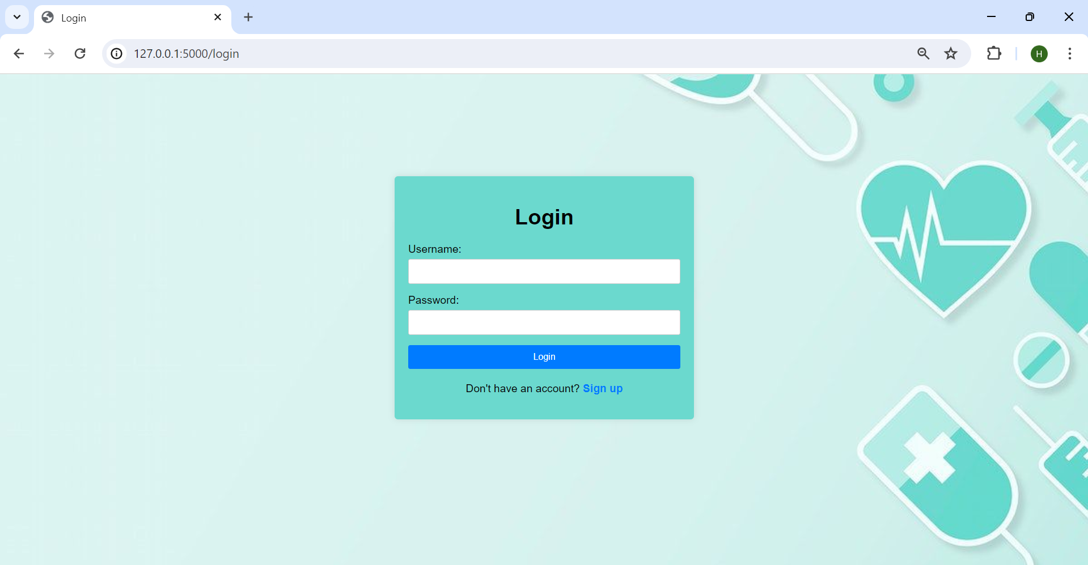
implementation

Slide 16
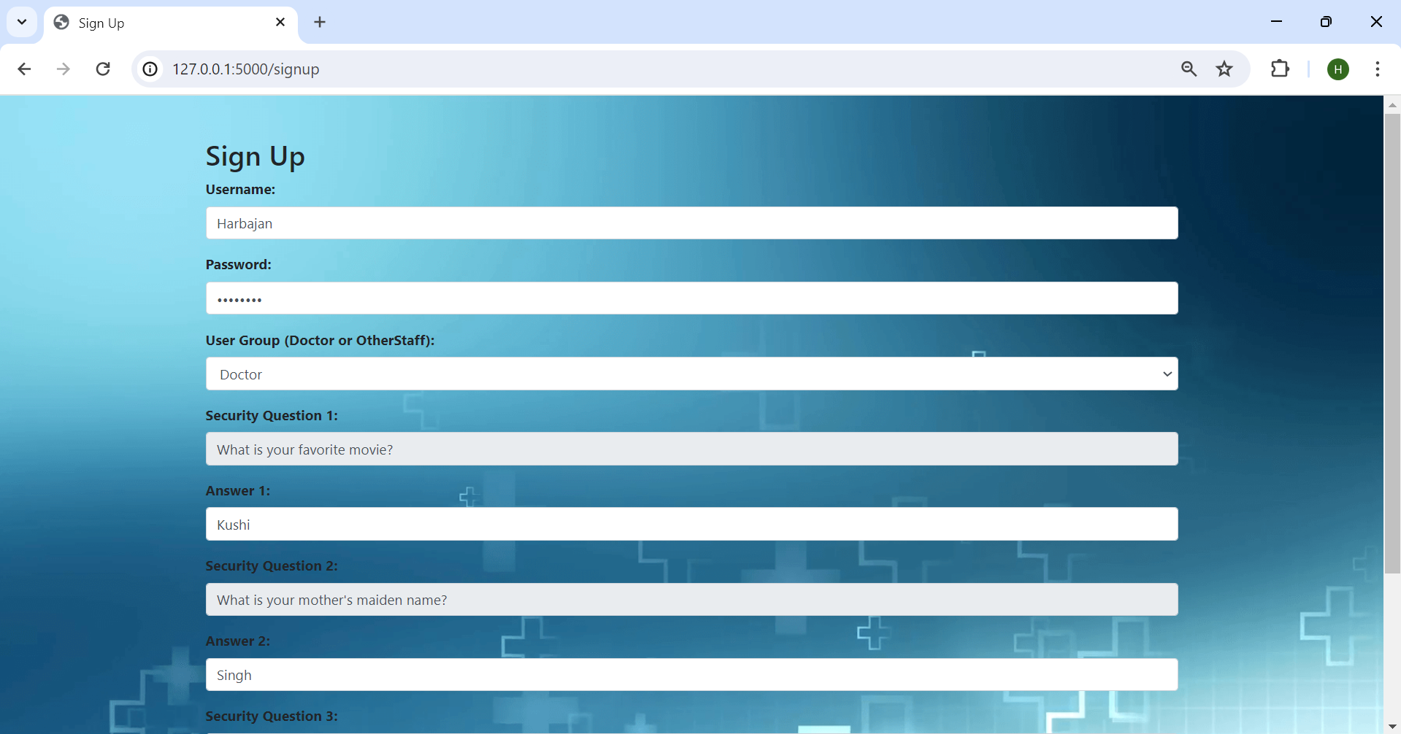
User signs up as doctor

Slide 17
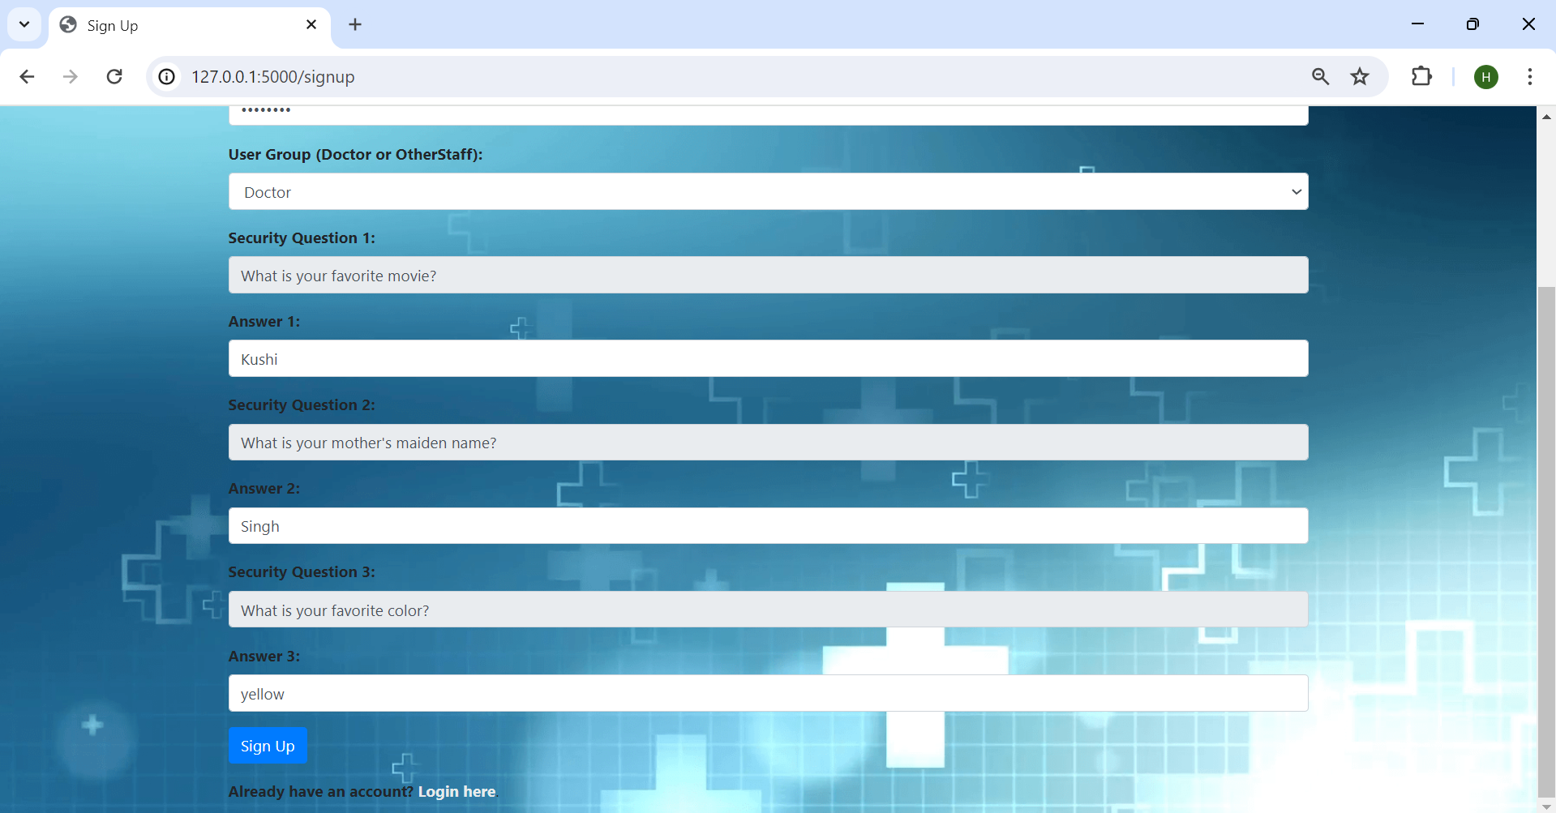
Provides relevant answers to security questions and signs up

Slide 18

Doctor login

Slide 19
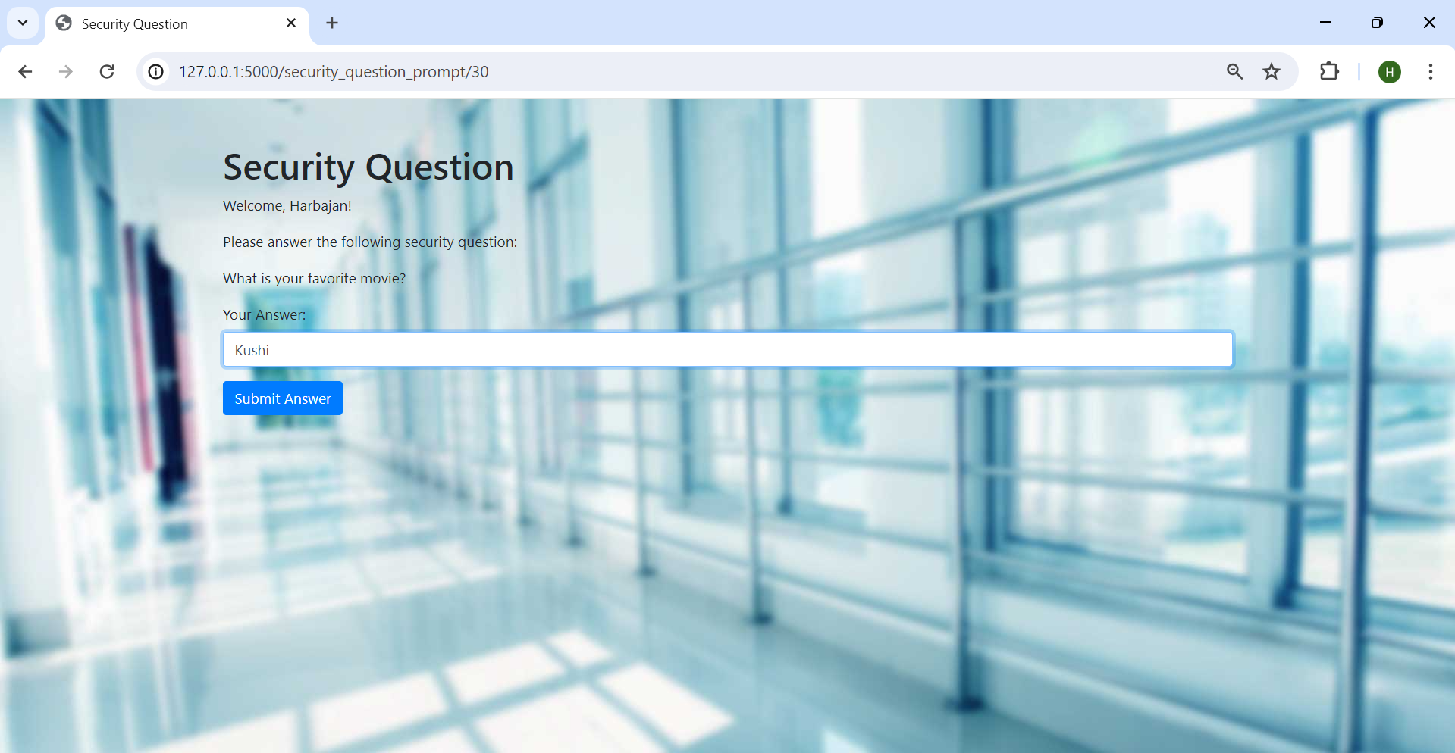
SEQURITY QUESTION PAGE
After giving correct username and password, user will be prompted to a security question page with a security question. Upon giving correct answer and if the answer matches with the answer which was given by user while signing up, the page navigates to patient database

Slide 20
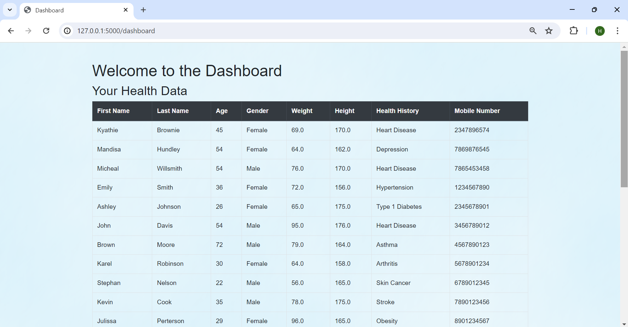
Doctor can have access to all the patient fields anD CAN have access to add a new patient

Slide 21
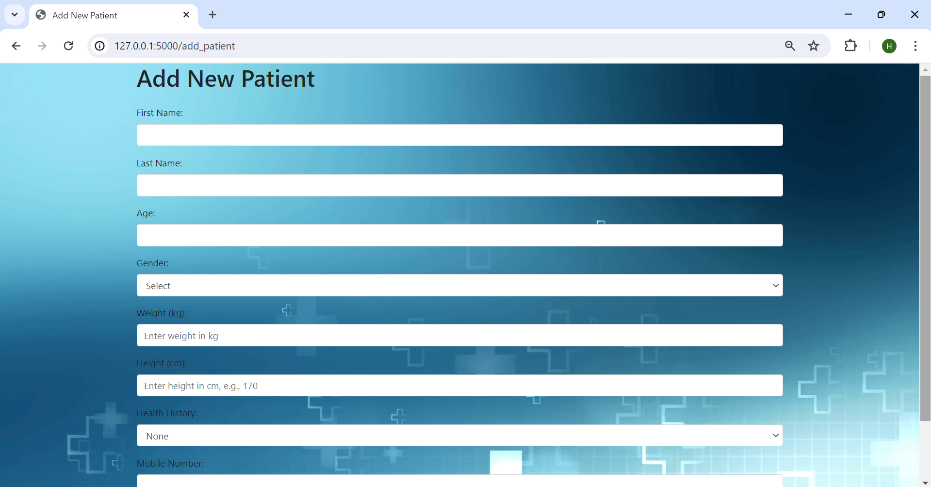
Doctor adds a new patient

Slide 22
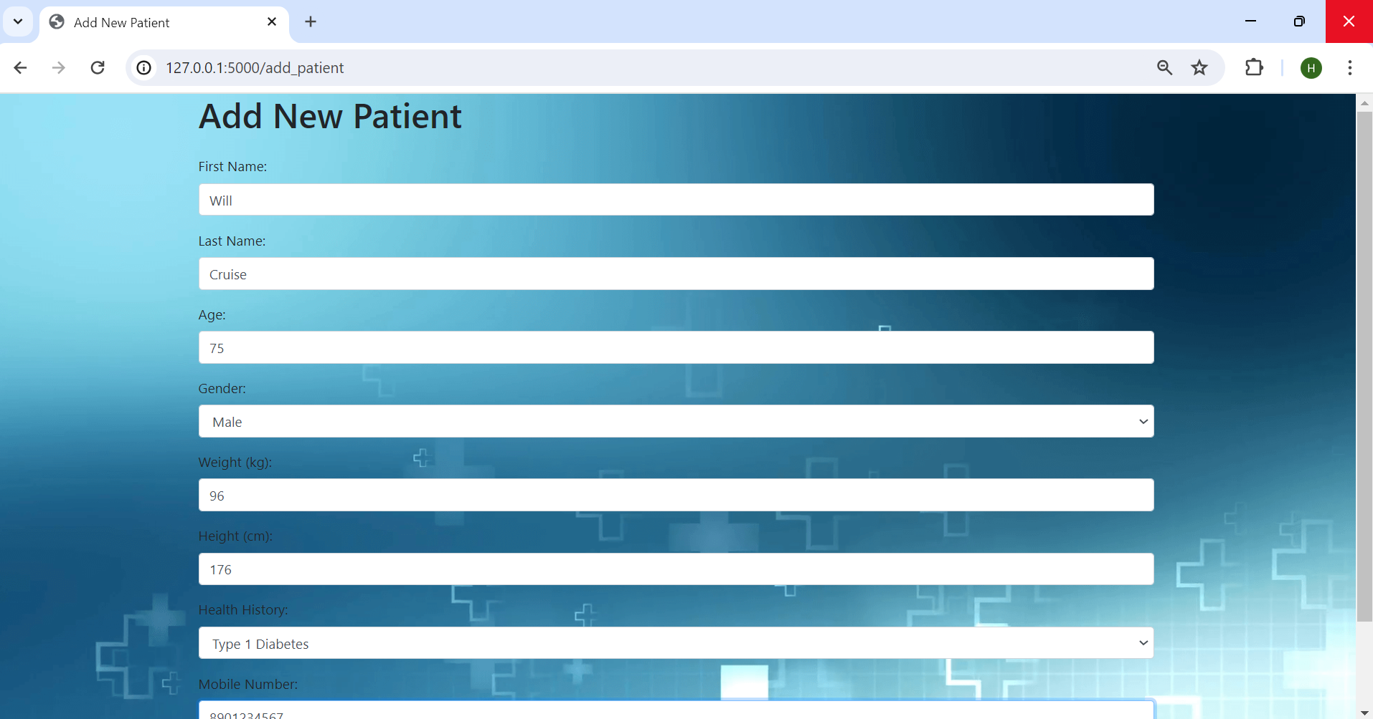

Slide 23
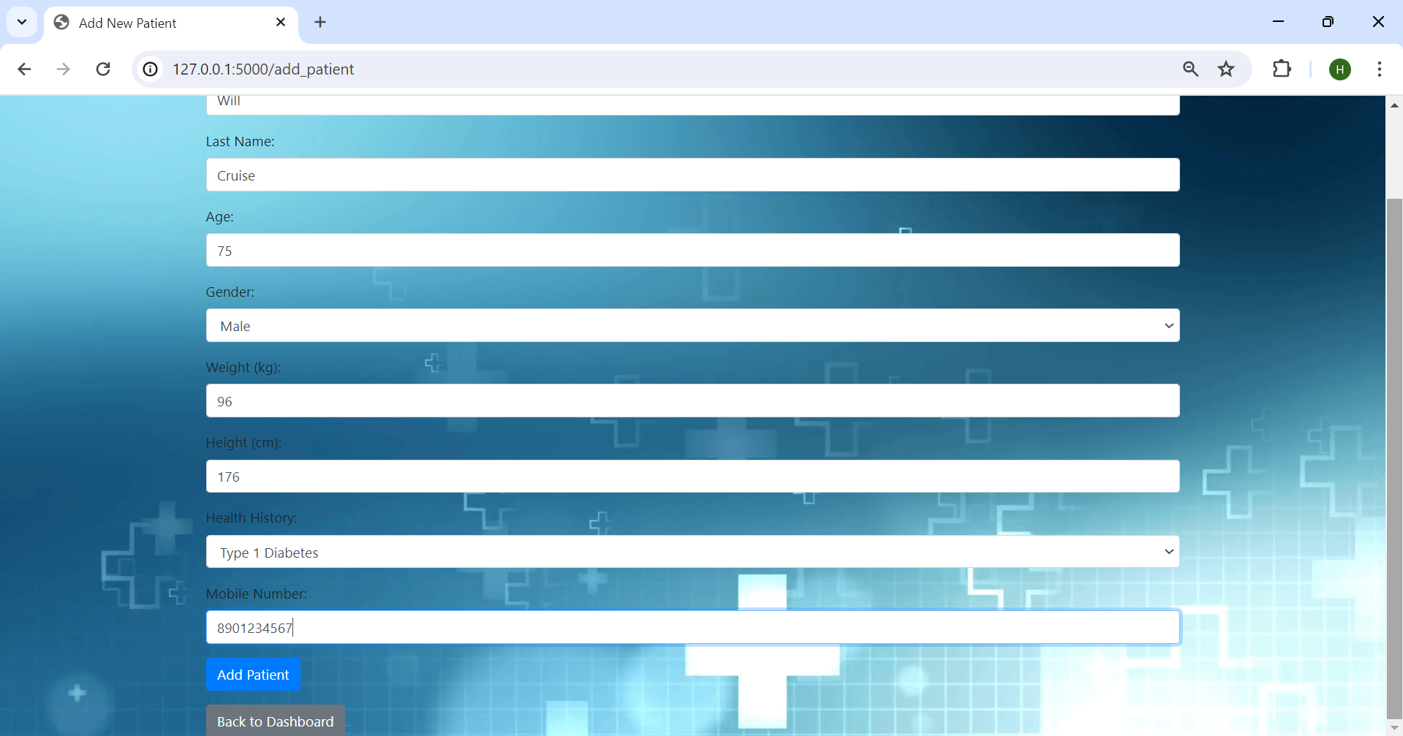
ADD NEW PATIENT PAGE

Slide 24
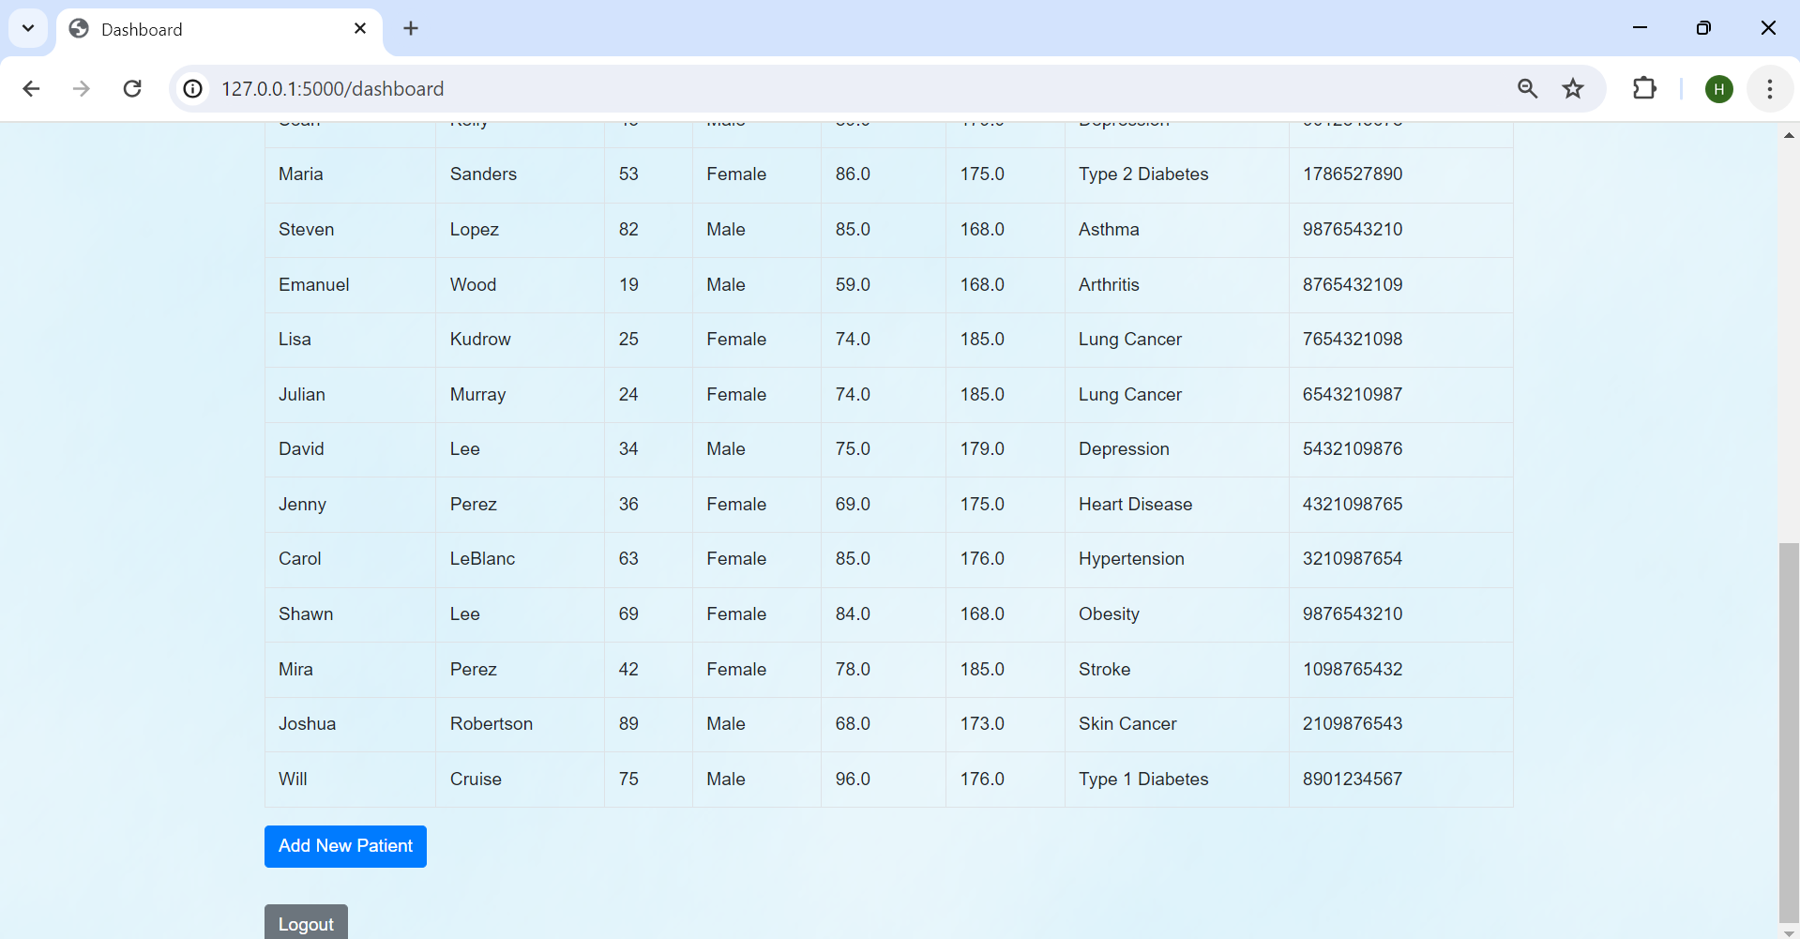
Patient added successfully

Slide 25
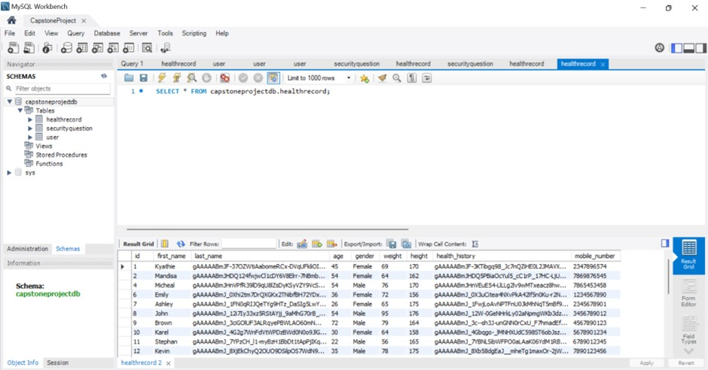
BOTH LAST NAME AND HEALTH HISTORY GETS ENCRYPTED AND STORED IN THE DATABASE

Slide 26
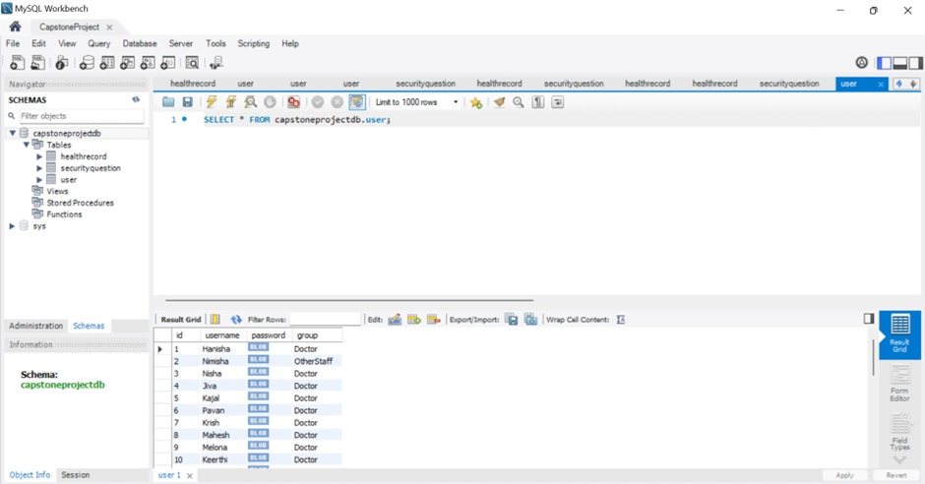
PASSWORD GETS ENCRYPTED AND STORED IN THE DATABASE

Slide 27
CONSLUSION
In conclusion, the Secure DBaaS for Health Records project represents a significant advancement in ensuring the confidentiality and integrity of sensitive healthcare data. By implementing robust encryption techniques and incorporating Multi-Factor Authentication (MFA), our solution provides a secure platform for managing patient details while maintaining usability and accessibility for authorized users. The successful integration of user signup, login, and data management functionalities demonstrates the efficacy of our approach in enhancing data security. Looking ahead, the project sets the stage for further enhancements, including the exploration of role-based access control and performance optimizations, to meet the evolving demands of healthcare data management. Overall, our project underscores the importance of prioritizing data security in healthcare systems to protect patient privacy and confidentiality effectively

Slide 28
REFERENCE
1. Z. Chkirbene, R. Hamila and A. Erbad, "Secure Medical Data Sharing For Healthcare System," 2022 IEEE 33rd Annual International Symposium on Personal, Indoor and Mobile Radio Communications (PIMRC), Kyoto, Japan, 2022, pp. 641-647, doi:10.1109/PIMRC54779.2022.9977665
2. Gupta, R.; Kanungo, P.; Dagdee, N.; Madhu, G.; Sahoo, K.S.; Jhanjhi, N.Z.; Masud, M.; Almalki, N.S.; AlZain, M.A. Secured and Privacy-Preserving Multi-Authority Access Control System for Cloud-Based Healthcare Data Sharing. Sensors 2023, 23, 2617. https://doi.org/10.3390/s23052617
3. Sivan, R.; Zukarnain, Z.A. Security and Privacy in Cloud-Based E-Health System. Symmetry 2021, 13, 742. https://doi.org/10.3390/ sym13050742

Slide 29
REFERENCE
Punithavathi, S., Jeyalaksshmi, S. Secure Block Chain-Based Healthcare Sensitive Data Prediction Using Pragmatic Quasi-Identifiers in a Decentralized Cloud Environment. SN COMPUT. SCI. 5, 41 (2024). https://doi.org/10.1007/s42979-023-02333-8
Rahman, M.M., Sifat, M.N.A., Rahman, M., Rahman, M., Mamun, S.A., Kaiser, M.S. HealthBlock: A Secured Healthcare System Using Blockchain. In: Hossain, M.S., Majumder, S.P., Siddique, N., Hossain, M.S. (eds) The Fourth Industrial Revolution and Beyond. Lecture Notes in Electrical Engineering, vol 980. Springer, Singapore (2023).https://doi.org/10.1007/978-981-19-8032-9_14
Mailthody, V. S., Wei, J., Chen, N., Behnia, M., Yao, R., Wang, Q., Agrawal, V., He, C., Wang, L., Chen, L., Agarwal, A., Richter, E., Hwu, W.-M., Fletcher, C., Xiong, J., Miller, A., & Patel, S. Safer Illinois and RokWall: Privacy Preserving University Health Apps for COVID-19. arXiv (2021). https://arxiv.org/abs/2101.07897v2

Slide 30
Punithavathi, S., Jeyalaksshmi, S. Secure Block Chain-Based Healthcare Sensitive Data Prediction Using Pragmatic Quasi-Identifiers in a Decentralized Cloud Environment. SN COMPUT. SCI. 5, 41 (2024). https://doi.org/10.1007/s42979-023-02333-8
Rahman, M.M., Sifat, M.N.A., Rahman, M., Rahman, M., Mamun, S.A., Kaiser, M.S. (2023). HealthBlock: A Secured Healthcare System Using Blockchain. In: Hossain, M.S., Majumder, S.P., Siddique, N., Hossain, M.S. (eds) The Fourth Industrial Revolution and Beyond. Lecture Notes in Electrical Engineering, vol 980. Springer, Singapore. https://doi.org/10.1007/978-981-19-8032-9_14
Mailthody, V. S., Wei, J., Chen, N., Behnia, M., Yao, R., Wang, Q., Agrawal, V., He, C., Wang, L., Chen, L., Agarwal, A., Richter, E., Hwu, W.-M., Fletcher, C., Xiong, J., Miller, A., & Patel, S. (2021). Safer Illinois and RokWall: Privacy Preserving University Health Apps for COVID-19. arXiv. https://arxiv.org/abs/2101.07897v2

Slide 31
Front End Background Reference links
https://wallpaperaccess.com/full/4112935.png
https://www.princess-jane.com/Glass/glass-bluecloudyglass.png
https://i.pinimg.com/originals/4c/98/4e/4c984ef0291409fef0a0942b391f6287.jpg
https://wallpapercave.com/wp/wp8003140.jpg

Slide 32
THANK YOU

